Slide 1
World Suicide Data
Project Team #7
Mujgan Guner, Ahmed Lotfy, Shanker Nair
June 25, 2020

Slide 2
NEW

Slide 3
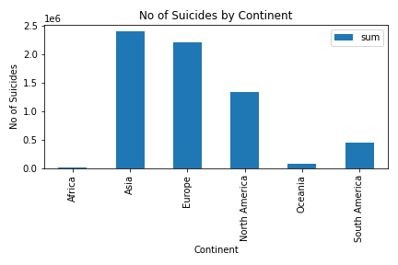
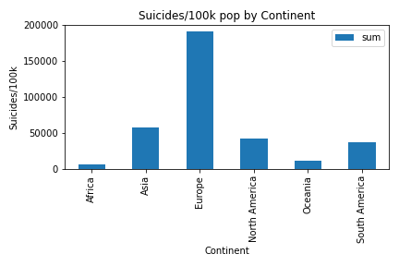
Suicide Number/Rate by Continent (Importance of normalization)

Slide 4
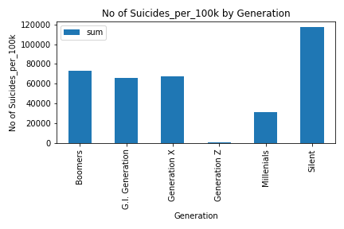
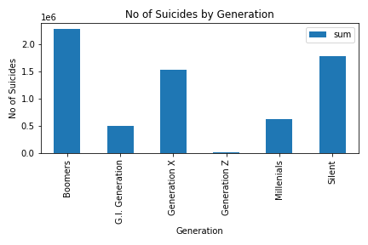
Suicide Number/Rate by Generation

Slide 5
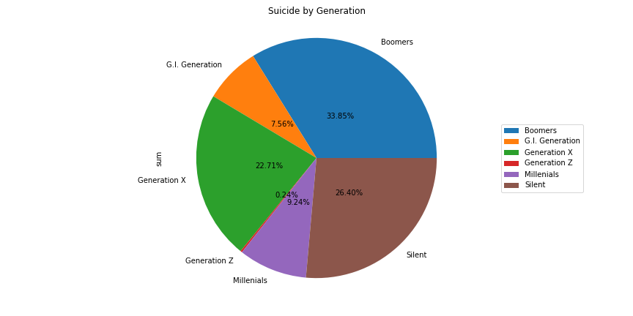
generation | age
Boomers | 25-34 years | 1154
 | 35-54 years | 3030
 | 55-74 years | 806
G.I. Generation | 55-74 years | 630
 | 75+ years | 2114
Generation X | 15-24 years | 2114
 | 25-34 years | 2682
 | 35-54 years | 982
 | 5-14 years | 630
Generation Z | 5-14 years | 1470
Millenials | 15-24 years | 2528
 | 25-34 years | 806
 | 5-14 years | 2510
Silent | 35-54 years | 630
 | 55-74 years | 3206
 | 75+ years | 2528

Slide 6
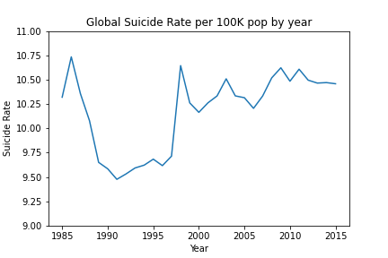

Slide 7
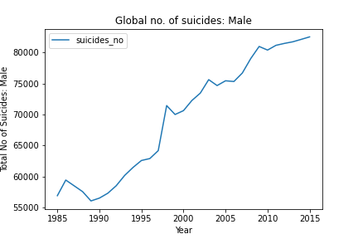
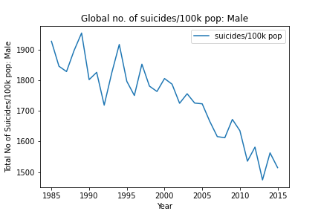
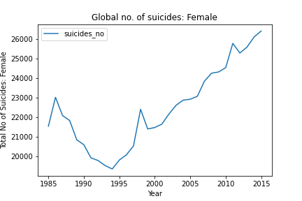
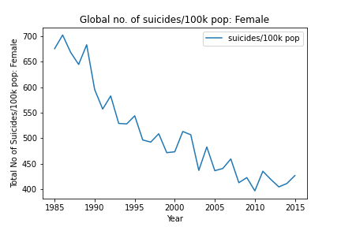
# Suicide number has only gone by by 35,000 from 1985 to 2016; however population has gone up by 300 million.
That explains why the suicide rate is going down with time

Slide 8
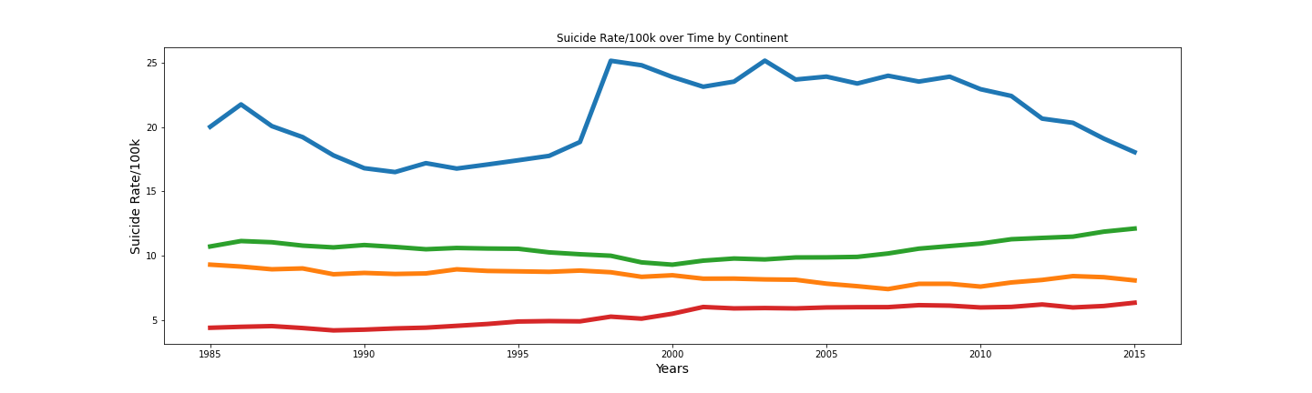

Slide 9
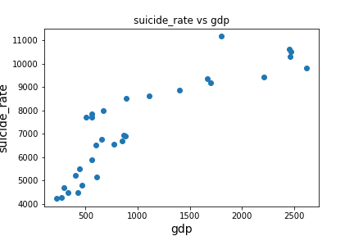
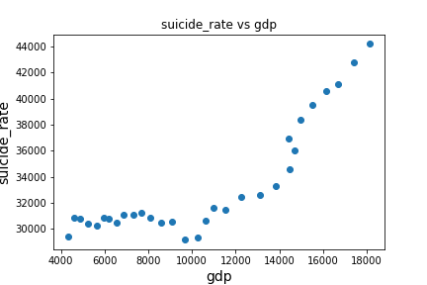
Brazil
USA

Slide 10
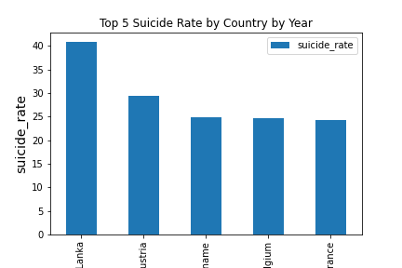
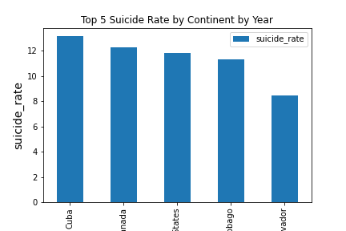
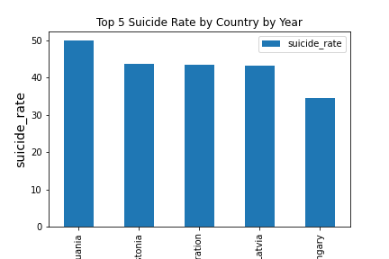
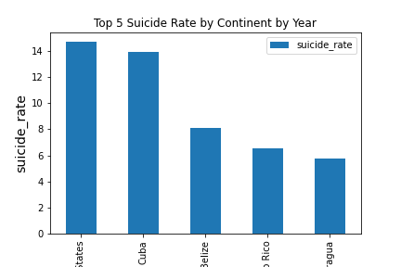
Top 5 countries by Year
1985
2005
1995
2015

Slide 11
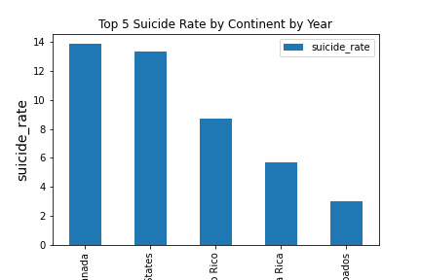
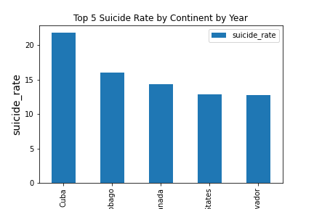
Top 5 countries by Continent/Year
1985
2005
1995
2015

Slide 12
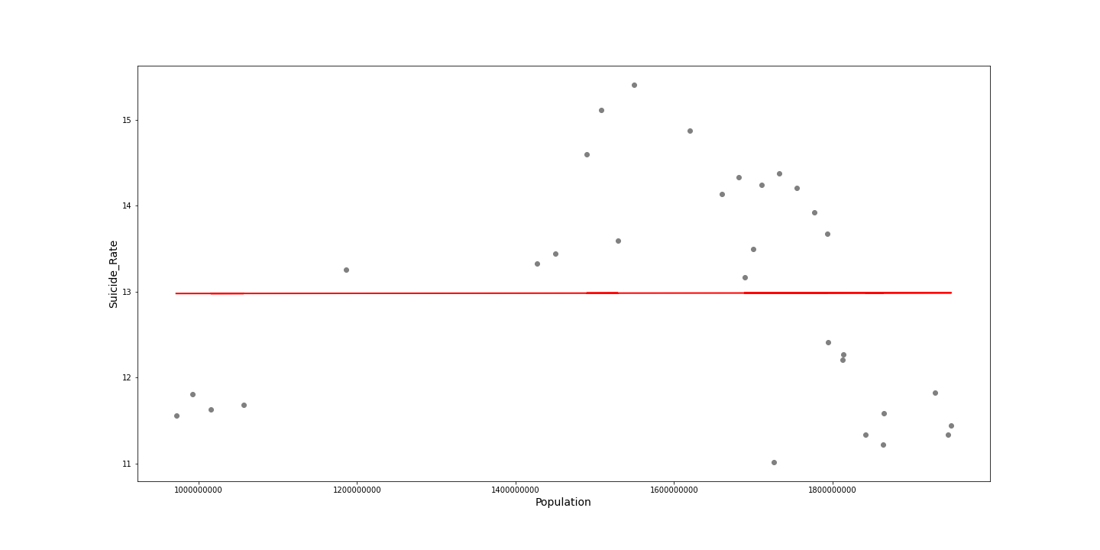
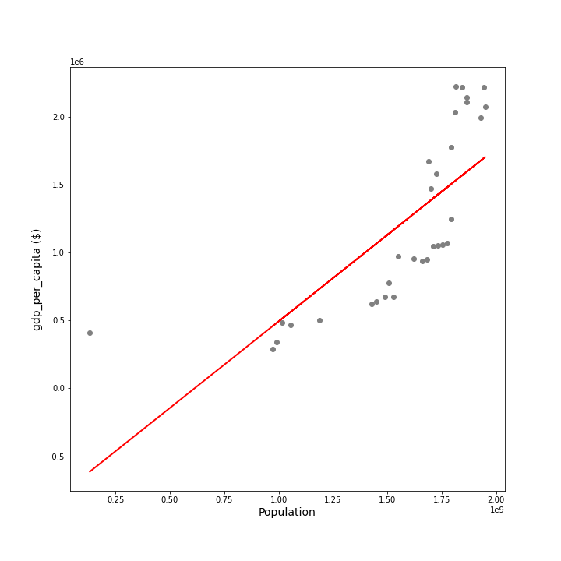

Slide 13
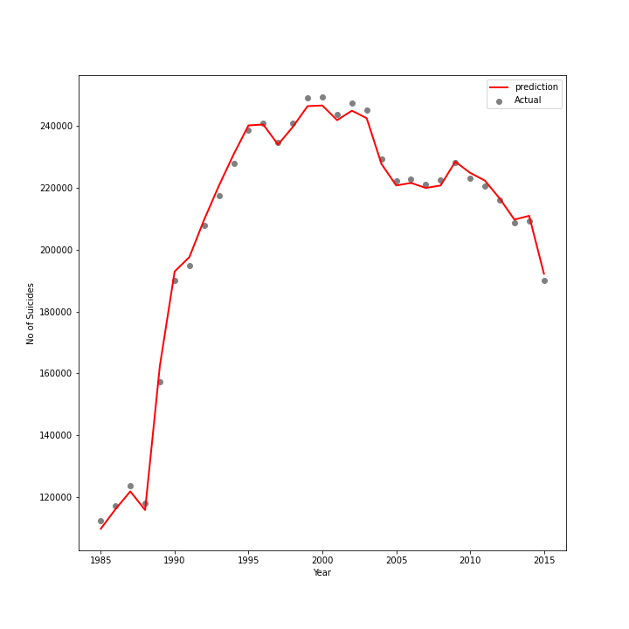
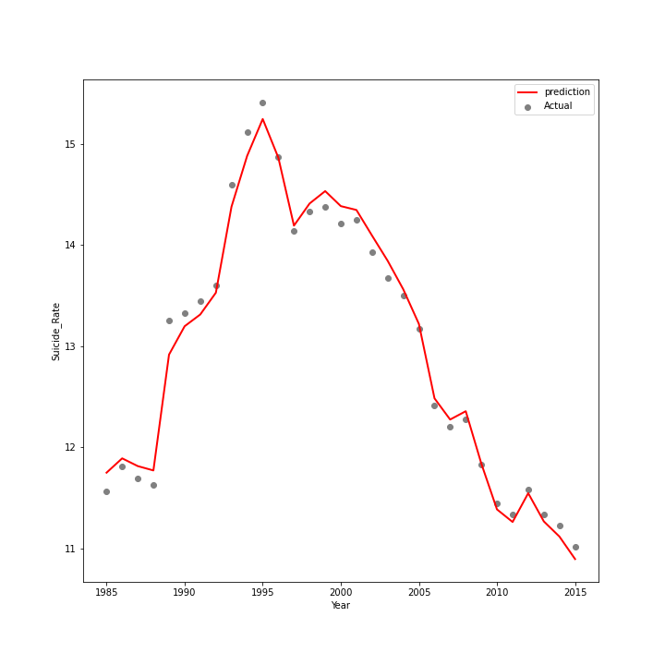
Multi variate regression Model
R2 =
R2 =

Slide 14
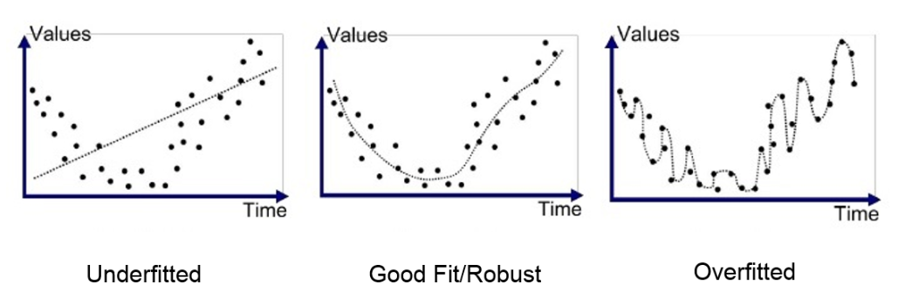
https://medium.com/analytics-vidhya/multiple-linear-regression-with-python-98f4a7f1c26c

Slide 15
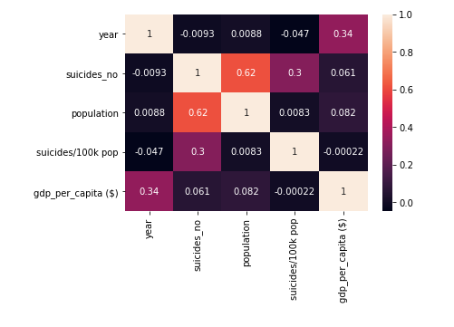

Slide 16
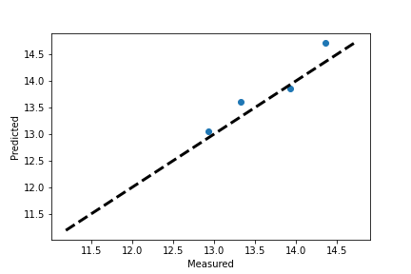
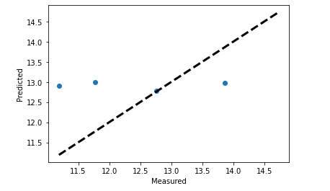
Multi variate regression Model
Italy
United States
R2 =
R2 =
RMSE
RMSE

Slide 17
CONCLUSIONS
The male suicide rate was 3.5 times the female suicide rate.
The highest suicide rate was seen in the oldest age group(75+). Further analysis showed a declining trend for the oldest age group, but a flat or increasing trend for all other age groups.
On a normalized basis, Europe had the highest suicide rate out of 6 other continents in the analysis.
The correlations between variables based on different data slices was presented.

